Slide 1


Pro EFT
Practitioners
Intensive
with
Lindsay Kenny

Slide 2


Introductions
In 30 seconds or less please
State your name
Where you are from
Your occupation
Your intention for this
class
© 2008-2014 ProEFT.com

Slide 3

Logistics
Restrooms breaks every 90 minutes +/-
Lunch 12:30 - 1:45 (go to lunch
with others)
End each day 5:30 - 6
© 2014 LKCoaching.com
Notes:
3
If you need to leave the room before the breaks, please do so quietly
Restroom locations

Slide 4

Asking Questions
Ask questions in front of the class
(instead of during breaks)
Raise your hand. When
called upon, ask question
Jot down questions that are
not on the current topic
Notes:
4
Rather than asking the facilitators during the breaks, please ask Facilitators questions about the workshop in front of the class for everyone’s benefit.
How to ask questions: Raise your hand, wait to be called upon, stand, state your name and the question..
9:15 Introduce Lindsay

Slide 5

Ground Rules:
Turn off cell phones (no texting,
surfing or tweeting, please)
No side talking (write notes)
Be back on time after breaks,
lunch and in your seats by 9am
every morning.
Maintain confidentiality
Notes:
5
Zoe
Ground rules:
Turn off cell phones and pagers, (and remember to do so again after breaks and lunch.)
No side talking when facilitators are speaking.
Respect others’ confidentiality.
Please respect others and the facilitators by being back from breaks on time. When you hear this music you will have 3 minutes to return to your seat (pause and I’ll play a few bars of James Brown’s “ I feel Good”) (We can make a clip and insert in into the PPT)

Slide 6

How this course will work
Presentation  Q & A
Demo  Q & A
Practice  Q & A
Break (15-30 mins.)

Slide 7
Your job is to …
Participate at 100%
Take notes like crazy
Be supportive of fellow students
Be responsible for your experiences
The quality of your experience
is contingent upon the level
of your participation
Notes:
7
LK
Your job is to:
--Stay present
-Participate at 100%
-Remain open minded Open your mind and suspend judgments. (Reiterate this rather than just stating it.)
-Be supportive of your fellow students and
-Be 100% responsible for your own results
11:15-11:30 Break
11:30 – 12:25
LK
The unconscious and conscious mind and how perception drives us (through the unconscious Mind)… making decisions based on false information all day = sabotage etc. It’s not our genes or hormones that make us who we are. Nor is it our environment. It’s our perception.
Bundling Baggage intro and demo-
95% of the issues people have are founded in repetitive, negative childhood experiences. It’s what keeps us out of the right vibration, more than anything else.
11:40 –12:15 T-up for BB, bring up volunteer, do demo, include Reversals as you go
12:15 LK Group tapping on eliminating Baggage.

Slide 8
Basic EFT
Techniques You
Should Know
The “Basics and Beyond” Sequence and Progressive Formula (with additional tapping points)
Borrowing Benefits
Finding core issues and when to be specific
Choices Method

Slide 9
Pro EFT™ Techniques
You Should Already Know…
Recognizing complex vs. simple issues
The Golden Gate Technique
Bundling Baggage Technique
First 2 types of Reversals and Neutralization
Muscle Testing

Slide 10

New
Reversals
Protocol
To Neutralize an SBS Reversal: Tap on the KC Point while saying:
“Even though this anger keeps me
stuck, there’s a part of me that
doesn’t want to let it go. And I love
and accept myself anyway.”
Notes:
LK Do demo, include and teach Reversals as you go (intro Borrowing Benefits)
Break 11:15

Slide 11

New Reversals Protocol
Formula
“Even though...
…this anger is keeping me agitated (How
the issue affects your life)
…there’s a part of me that doesn’t want to
let it go (the resistance statement)
…And I (want to) love and accept myself
anyway (the affirmation or acceptance statement)
Notice that the word HAVE is not used!

Slide 12
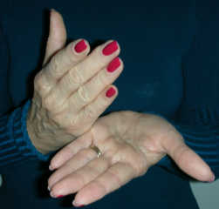
Ways to frame a
Reversal - Setup Statement
“Even though….
  … this fear of flying keeps me grounded, there’s a part of me that doesn’t want to release it…
  … this shame and embarrassment about my weight keeps me from socializing, there’s a part of me that wants to punish myself with it…
  … I want to accept myself anyway.”
s

Slide 13
More Reversal – Setup
Statement Examples
“Even though…
  … this resentment at _____ is keeping us apart, there’s a part of me doesn’t want to let it go…
  … these limiting beliefs keep me from having _____, a part of me doesn’t want to let them gos…
  … this debilitating _______, keeps me from
  having a normal life, there’s a part of me that doesn’t want to be well…
  … and I accept myself anyway.”s

Slide 14
Subconscious Reasons for Resistance
  … it’s not safe to let it go
  … it’s not acceptable to get over it
  … it’s how I punish myself
  … it’s how I punish ________
  … I don’t know who I would I be without this
  … I don’t deserve to get over it
  … it gives me an excuse to …

Slide 15
Important to Remember:
Neutralizing a Reversal does not fix the problem
It fixes the impediment
to fixing the problem
After neutralizing a Reversal you
still need to tap on the ISSUE

Slide 16
Dyads
on Reversals and Muscle Testing
  Find a partner and sit facing each other
  Decide who starts as “A” (Coach)
  Switch roles when we ask you to
Notes:
Dyads to Practice Bundling Baggage
1 Find a partner and introduce yourself
2 Put your chairs together facing each other
3 Decide who is partner A (the coach), / (partner B is the “client”)

Slide 17
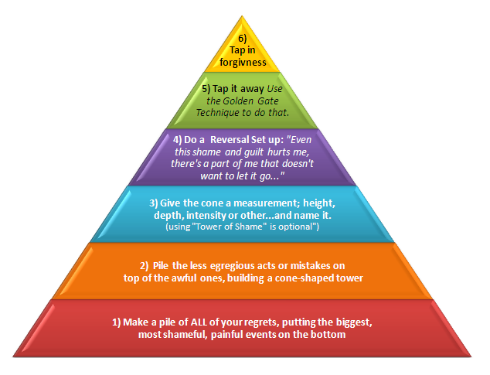
Pro EFT™ Techniques and
Skills You will Learn
Relationship Remedy*
Role-Reversal Technique*
Belief Busting Technique
Ultimate Truth Statement
(More of) The Tapping Tree
Tower of Shame*
Surrogate tapping (webinar)

Slide 18

More Skills & Techniques
Personal Power Process (webinar)
The PHOOSIE Method*
Ultimate Choice Technique*
Dan Rather Technique*
Ping-ponging
Revenge tapping*
s
* may be taught during the Continuing Ed Program

Slide 19
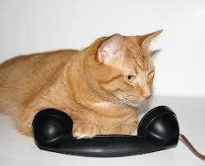
You will also learn
how to:
Handle difficult or hard-to-
measure issues
Pre-frame and Re-frame (webinar)
Finely tune your intuition*
Do professional phone sessions
Master the Art & Science of Tapping (webinar)
* may be taught during the Continuing Ed Programs

Slide 20
You will also learn:
How to use Pro EFT™ for stuck issues;
weight, clutter, procrastination, etc.
How to what and know to refer out (webinar)
The anatomy of a session
Market and promote yourself (webinar)
H’oponopono (webinar)

Slide 21

Even though I’m feeling anxious and overwhelmed, I love and accept myself anyway …
Even though I feel I’m already behind, I allow myself to absorb everything quickly and recall it easily .
I choose to be calm and relaxed, making this material easy to learn and incorporate.

Slide 22


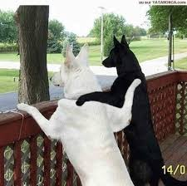

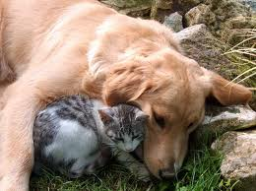

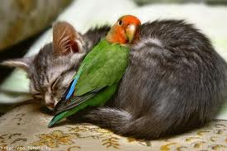

Workshop Buddies
Be responsible for your Buddy

Slide 23
10 Minute Break
Pick your Class Buddy

Slide 24

Who doesn’t have a buddy?

Slide 25
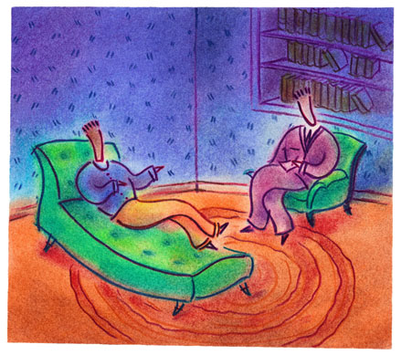
Why do you want to be a
Pro EFT™ Practitioner?
  To help others
  To make a difference
  To earn a good living
  It’s rewarding and fulfilling
  To work from home & set your own schedule

Slide 26
What are the characteristics of a
good practitioner?
Good listener / Empathetic
Compassionate / Caring
Skilled and knowledgeable in Tapping
Non-judgmental / accepting (open-minded)
Intuitive / Being a good detective!

Slide 27
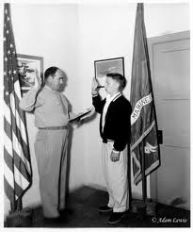
Rate this statement for truth:
“I am already a good practitioner”

Slide 28


What are the characteristics of an Ultimate Practitioner?
Confidence
Sense of humor
Trust in self
Healthy self-esteem
Certainty

Slide 29

More characteristics of an Ultimate Practitioner?
Commitment to:
  continue to grow and learn
  continue work on own issues
  hone and improve confidence & skills
  Practice with peer)

Slide 30

What’s in the way
of you being an ultimate
practitioner?

Slide 31
Limiting Beliefs
& Fears
About being an ultimate practitioner
I don’t know enough about Pro EFT™
What if I hurt someone?
I’m just not good enough yet
It’s not OK to make money
helping people

Slide 32
… Beliefs & Fears
What if people ask me about my qualifications
I don’t have letters after my name, so ….
What if I fail?
What if I don’t know what to say?
People will think tapping is weird?
Can I make a living at this?
Notes:
3 major obstacles that keep us from feeling good (in resistance)
Limiting beliefs
Negative messages and events- from the daily bombardment of bad news
(fade in out quickly with 5 or 6 images)
Our own negative thinking”- “this will never work!” “What’s wrong with me?” “Why do I keep screwing up??”
“I can’t do anything right” “I can never hold on to money”

Slide 33
Red Flag Alert!
Self asked questions are almost always fear-based, AND limiting beliefs:
  Will I be able to…
  Can I … ?
  What if I can’t…?
  What if they…?
  Will this last?
  How I’m I going to…?

Slide 34


What beliefs
& fears
create
your
glass ceiling
or
prison?

Slide 35

Belief Busting Technique
Notes:
10:45 – 11:15 BB demo
And that’s what the Bundling Baggage technique is all about. It’s easy, quick and highly effective.
So how many of you want to learn how?
BRING UP VOLUNTEER TO DEMONSTRATE

Slide 36
Bundle Together
fears
Limiting Beliefs
Traumas & Circumstances
… about being a great practitioner

Slide 37
Steps to the
Belief Busting Technique
part 1
Identify and “bundle” together all limiting
belief and fears about __________.
Give your Bundle a name
Identify the pull it has on you: 10 to 1
Do a Reversal Neutralization (on the B’s & F’s)
- “ET these B’s and F’s keep me from getting
what I want, there’s a part of me that doesn’t
want to let them go…”
Notes:
Steps for Bundling Baggage-
1 Define repetitive childhood events
2 Bundle them together and give the bundle a name, such as:
Childhood traumas (or abuses)
Tormenting siblings
Confused, lost childhood
Detached, cold mom
Drunk dad beatings
Assign an intensity level 10 to 1

Slide 38
Part 2 of the
Belief Busting Technique
Tap away beliefs (use Golden Gate template)
When at a zero, test results
Install positive beliefs… “I allow this work.
I’m smart and resourceful…I choose to trust myself…”
Notes:
Steps for Bundling Baggage-
1 Define repetitive childhood events
2 Bundle them together and give the bundle a name, such as:
Childhood traumas (or abuses)
Tormenting siblings
Confused, lost childhood
Detached, cold mom
Drunk dad beatings
Assign an intensity level 10 to 1

Slide 39
Dyads
on Limiting Beliefs and Fears
  Find a partner and sit facing each other
  Decide who’s partner “A” (the starting coach)
  Identify some of your fears &
  beliefs (about being a great practitioner)
  Tap them away (do a Reversal Set-Up!)
  Switch Roles when time is up
Restroom break as needed
Notes:
Dyads to Practice Bundling Baggage
1 Find a partner and introduce yourself
2 Put your chairs together facing each other
3 Decide who is partner A (the coach), / (partner B is the “client”)

Slide 40
Dyads
on Limiting Beliefs and Fears
  Find a partner and sit facing each other
  Decide who’s partner “A” (the starting coach)
  Identify some of your fears &
  beliefs (about being a great practitioner)
  Tap them away (do a Reversal Set-Up!)
  Switch roles when asked to
Restroom break as needed
Notes:
Dyads to Practice Bundling Baggage
1 Find a partner and introduce yourself
2 Put your chairs together facing each other
3 Decide who is partner A (the coach), / (partner B is the “client”)

Slide 41

Lunch time
Please eat with others
Please be in your seats by 1:45

Slide 42


Our intention is to provide you with
The BEST Tapping
Tools and Knowledge
+
PowerPoint presentations
Lectures and stories
Benefit of our experience
Demonstrations
Free teleclass audios
Supervised practice
Unique, efficient processes
Superior support material

Slide 43
BIG
Surprise
  Our Goal
  is to support you in becoming an
  Ultimate Practitioner

Slide 44

Practitioners
Online Support Library!!!
tinyurl.com/SupportLibrary

Slide 45
Just a few of the things in
the Support Library
Templates; for brochures, biz cards, flyers,
client confo letters, intake forms, tracking
sheets, e-mail responders, registration cards
Links to important sites you need to know
Dozens of Lindsay’s articles, eBooks and handouts
Dozens of free audios videos, downloads and material
Marketing and Promotional tips, audios & homework
Tips on doing workshops, webinars and teleclasses
Articles from Carol Look, Pat Carrington and others
Tips on writing articles, doing work for non-profits
Links to experts who can help you
Anything else you can think of
Tons and tons of valuable stuff.
Too much to put on this slide!

Slide 46
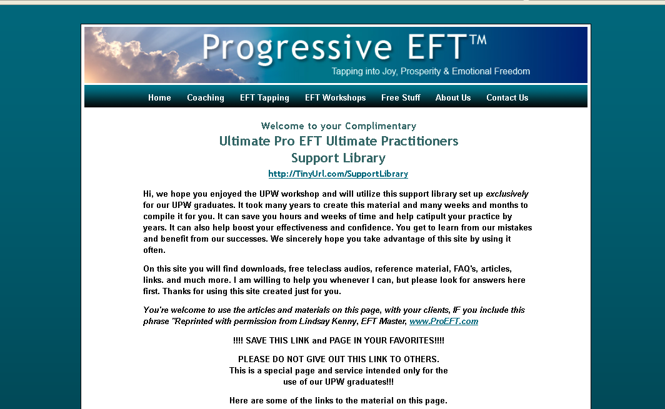

Slide 47
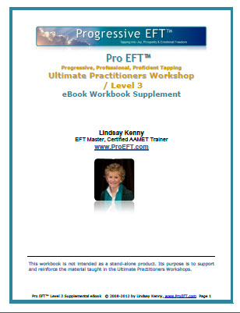
Another Little Surprise
Online, downloadable UPW Workbook!
http://tinyurl.com/WorkbookSuppl
12 Tips for More Effective
Tapping eBook
Clearing Clutter for Clarity –
using the UTS
Protecting Yourself from
Unwanted Energy
Marketing Your Practice Tips
by Carol Tuttle

Slide 48
And More Content
Feeling Conflicted, Torn or Indecisive
Tap Away Anger
The Importance of Writing Articles
Change Your Life by Changing Your Thoughts
Working with Vets on the PTSD - part 1 and 2
http://tinyurl.com/WorkbookSuppl

Slide 49


All you need to add is
Confidence & Wisdom...
Practice &
Experience!

Slide 50
Practice and Experience
Helps Develop:
        Confidence
        Improved judgment
        Your own style
        Finely tuned intuition
        Excellence & Expertise
        Better Skills & Finesse
        Certainty
        Trust in yourself

Slide 51

Complex Issues
Defining complex issues
Approaching
Resolving them

Slide 52


Defining Complex Issues
Simple issues are:
  Single-faceted, current & measurable;
Complex issues are:
  Multi-faceted, older, multiple occurrences, often difficult to measure
Some issues that appear to be
simple can be quite complex.

Slide 53
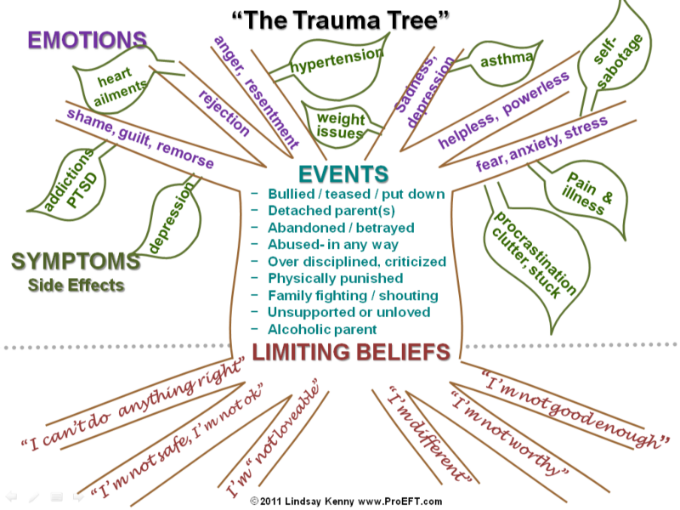
The Tapping Tree
Trunk = Event(s) or Circumstances
Branches = Negative Emotions
Leaves = Symptoms or Side Effects
Roots = Limiting Beliefs

Slide 54
EMOTIONS
“The Trauma Tree™”
self-
sabotage
hypertension
asthma
heart
disease
anger, resentment ,
frustration
sadness, grief
rejection, heartbreak
weight
issues
helpless, powerless
shame, guilt, remorse
fear, anxiety, stress
Stuck
issues
Events…Circumstances
addictions
Flawed parents; detached
alcoholic, controlling, mean
Mistreated; bullied, teased
Abandoned; in any way…
Abused; in any way…
Judged; criticized, put down
Traumatized; fighting, drama
Molested; in any way…
depression
pain & illness
procrastination
clutter
SYMPTOMS
Issues
LIMITING BELIEFS
Something's wrong with me
“I can’t do anything right”
I’m not good enough
“I’m different”
“I’m not worthy”
I’m “not loveable”
“ I’m not ok….I’m stupid
I’m not safe
© 2013 Lindsay Kenny, www.ProEFT.com

Slide 55
Demo

Slide 56
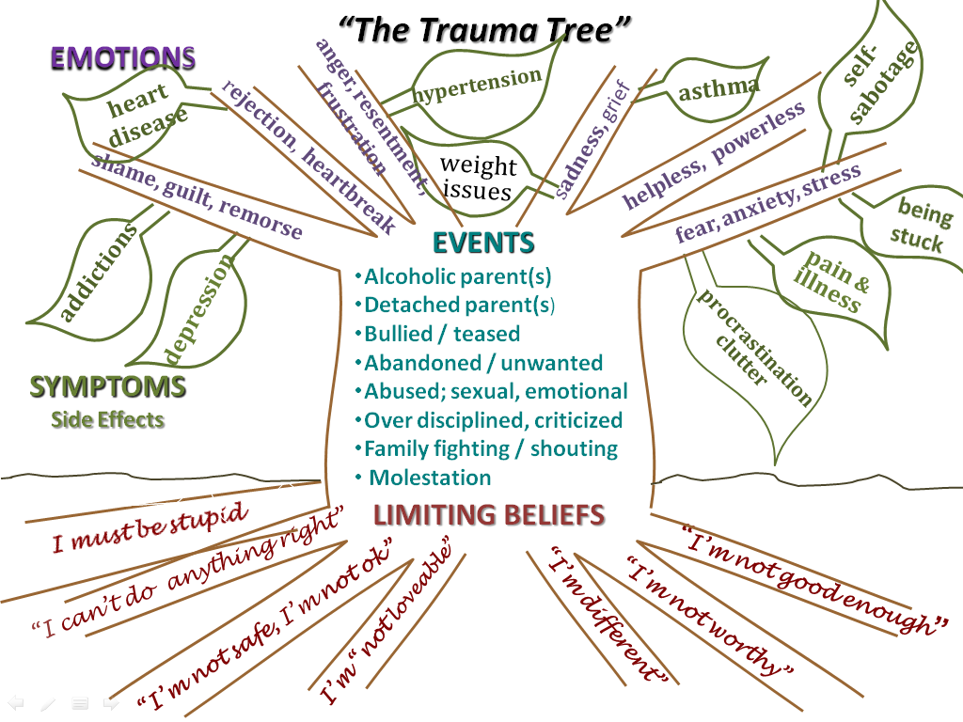
Steps to Tapping it Away
Give your “tree” a name; Tree of Trauma,
Whomping Tree, Tree from Hell, Wretched Life Tree, etc.
Assign an Intensity (10- 1) by “sitting in the branches” and guessing what it would feel like
Do a Reversal Neutralization “Even though this tree affects me in negative ways, there’s a part of me that doesn’t want to let it go…”

Slide 57
Steps to Tapping it Away
Tap it Away – using the Golden Gate Technique “this tree of misery… all the fear and anxiety… the trauma and lack of support… the sadness & disappointment…
Test – to make sure all elements are cleared (except the leaves)

Slide 58
Dyads to Practice the
Tapping Tree

Slide 60
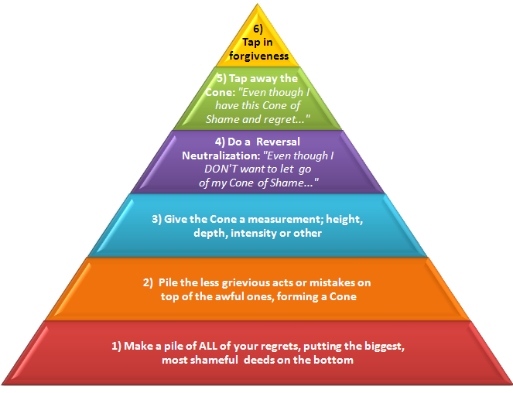
Tower of Shame

Slide 61
Steps to Eliminating
Tower of Shame
Imagine ALL of the despicable things you’ve EVER done, said or thought!
Pile them up as you think of them
“Jump” into the center of the pile or tower

Slide 62
Final Steps to Eliminating
Tower of Shame
Give the feelings (shame, guilt, remorse…) a rating 10-1
Do a Reversal on NOT wanting to let it go
Tap away the tower
Test the results

Slide 63
Dyads on Tower of Shame

Slide 64
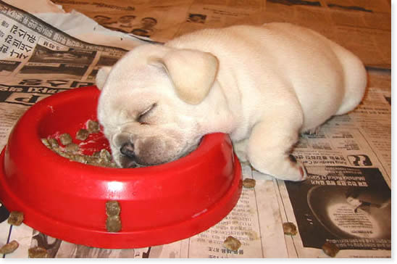
Overnight Assignments:
Pick a partner to practice the Trauma Tree and
Tower of Shame
Review your notes from today
Please be in (a different seat) by 9:00 a.m.

